Slide 1



Earthquake Analysis
View in Power BI
Last data refresh:
03/05/2025 16:12:44 UTC
Downloaded at:
03/05/2025 16:14:52 UTC

Slide 2
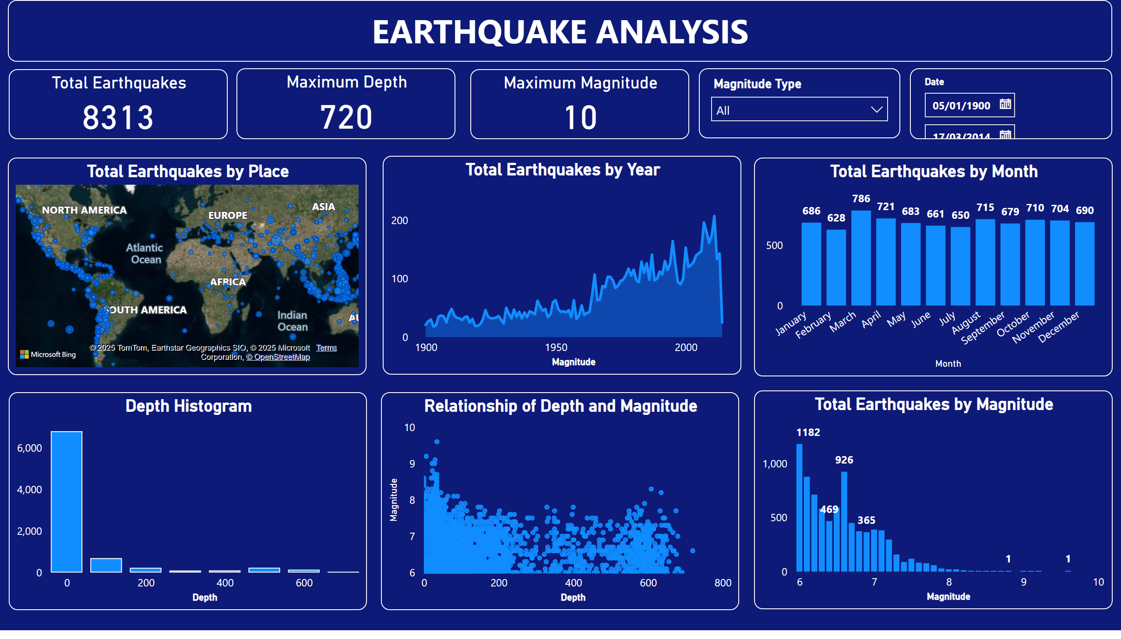
Page 1
Notes:
slicer
No alt text provided
slicer
No alt text provided
textbox
No alt text provided
Total Earthquakes
No alt text provided
Maximum Depth
No alt text provided
Maximum Magnitude
No alt text provided
Total Earthquakes by Month
No alt text provided
Total Earthquakes by Magnitude
No alt text provided
Total Earthquakes by Year
No alt text provided
Depth Histogram
No alt text provided
Relationship of Depth and Magnitude
No alt text provided
Total Earthquakes by Place
No alt text provided

